Slide 1

Data science specialization course

Slide 2
What is Data Science?
Definition: Data science is an interdisciplinary field that utilizes scientific methods, algorithms, and systems to extract insights and knowledge from structured and unstructured data.
Key Components: Data science involves various disciplines such as statistics, machine learning, data analysis, and data visualization.
Applications: Data science is applied in numerous fields including business, healthcare, finance, marketing, and more.
Importance: Data science helps organizations make informed decisions, predict future trends, and gain competitive advantages.
Skills Required: Data scientists typically possess skills in programming, statistics, data wrangling, and domain knowledge.

Slide 3
Tools for Data Science
Python: A versatile programming language with rich libraries for data manipulation, analysis, and visualization.
R: Another popular programming language used for statistical computing and graphics.
SQL: Essential for querying and managing relational databases.
Jupyter Notebook: An interactive development environment ideal for data exploration and analysis.
Tableau: A powerful data visualization tool for creating interactive dashboards and reports.

Slide 4
Data Science Methodology
CRISP-DM: A widely-used methodology consisting of six phases - Business Understanding, Data Understanding, Data Preparation, Modeling, Evaluation, and Deployment.
Agile Data Science: An iterative approach that emphasizes collaboration, adaptability, and continuous improvement.
OSEMN Framework: Another methodology comprising five stages - Obtain, Scrub, Explore, Model, and iNterpret.
KDD Process: Knowledge Discovery in Databases involves steps like data selection, preprocessing, transformation, data mining, and interpretation.
Lean Six Sigma: A data-driven methodology focused on improving process efficiency and quality through statistical analysis.

Slide 5
Python for Data Science, AI & Development
Basics of Python: Data types, control structures, functions, and object-oriented programming concepts.
Libraries for Data Science: Pandas for data manipulation, NumPy for numerical computing, and Matplotlib/Seaborn for data visualization.
Machine Learning with Scikit-learn: Implementation of various machine learning algorithms for classification, regression, clustering, etc.
Deep Learning with TensorFlow/Keras: Building and training neural networks for artificial intelligence applications.
Web Development with Flask/Django: Creating web applications for deploying data science models or building AI-powered websites.

Slide 6
Python Project for Data Science
Project Planning: Defining project objectives, scope, and deliverables.
Data Collection: Gathering relevant datasets from various sources such as APIs, databases, or web scraping.
Data Preprocessing: Cleaning, transforming, and preparing the data for analysis.
Exploratory Data Analysis (EDA): Understanding the data through statistical summaries, visualizations, and insights.
Model Building and Evaluation: Developing machine learning models, tuning hyperparameters, and assessing model performance.

Slide 7
Databases and SQL for Data Science with Python
Relational Databases: Structured storage systems organized in tables with rows and columns.
SQL Basics: CRUD operations (Create, Read, Update, Delete), filtering, sorting, and aggregating data.
Database Connectivity in Python: Using libraries like SQLAlchemy or psycopg2 to connect Python applications with databases.
Data Manipulation with SQL: Joining tables, subqueries, and advanced SQL operations.
Performance Optimization: Indexing, normalization, and query optimization techniques for improving database performance.

Slide 8
Data Analysis with Python
Data Loading: Importing data from various formats like CSV, Excel, JSON, or databases.
Data Cleaning: Handling missing values, outliers, and inconsistencies in the dataset.
Statistical Analysis: Descriptive statistics, hypothesis testing, and correlation analysis.
Feature Engineering: Creating new features from existing data to improve model performance.
Time Series Analysis: Analyzing temporal data for patterns, trends, and seasonality.

Slide 9
Data Visualization with Python
Matplotlib: Basic plotting library for creating static, two-dimensional visualizations.
Seaborn: Statistical data visualization library built on top of Matplotlib, offering enhanced aesthetics and functionality.
Plotly: Interactive visualization library for creating interactive plots and dashboards.
Geographic Visualization: Using libraries like Folium or Plotly Geo to visualize spatial data on maps.
Dashboard Creation: Integrating visualizations into interactive dashboards using tools like Dash or Streamlit.

Slide 10

Machine Learning with Python
Supervised Learning: Training models with labeled data for tasks like classification and regression.
Unsupervised Learning: Discovering patterns and structures in unlabeled data through clustering and dimensionality reduction.
Model Evaluation: Metrics like accuracy, precision, recall, and F1-score for assessing model performance.
Hyperparameter Tuning: Optimizing model performance by tuning parameters using techniques like grid search or randomized search.
Model Deployment: Exporting trained models for integration into production environments using frameworks like Flask or TensorFlow Serving.

Slide 11
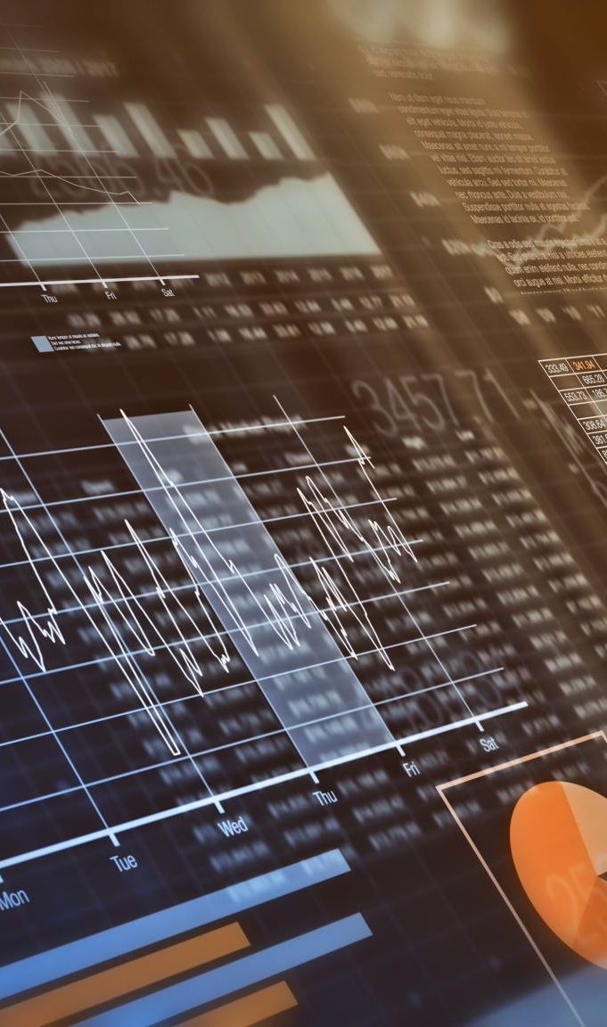
Applied Data Science Capstone
Project Overview: Brief summary of the capstone project objectives and scope.
Data Exploration: Insights gained from exploring the dataset, including key findings and challenges encountered.
Methodology: Approach followed for data preprocessing, model selection, and evaluation.
Results: Performance metrics of the final model and any additional insights or observations.
Future Directions: Suggestions for further improvements or extensions to the project, including potential next steps or additional analyses.

